Slide 1
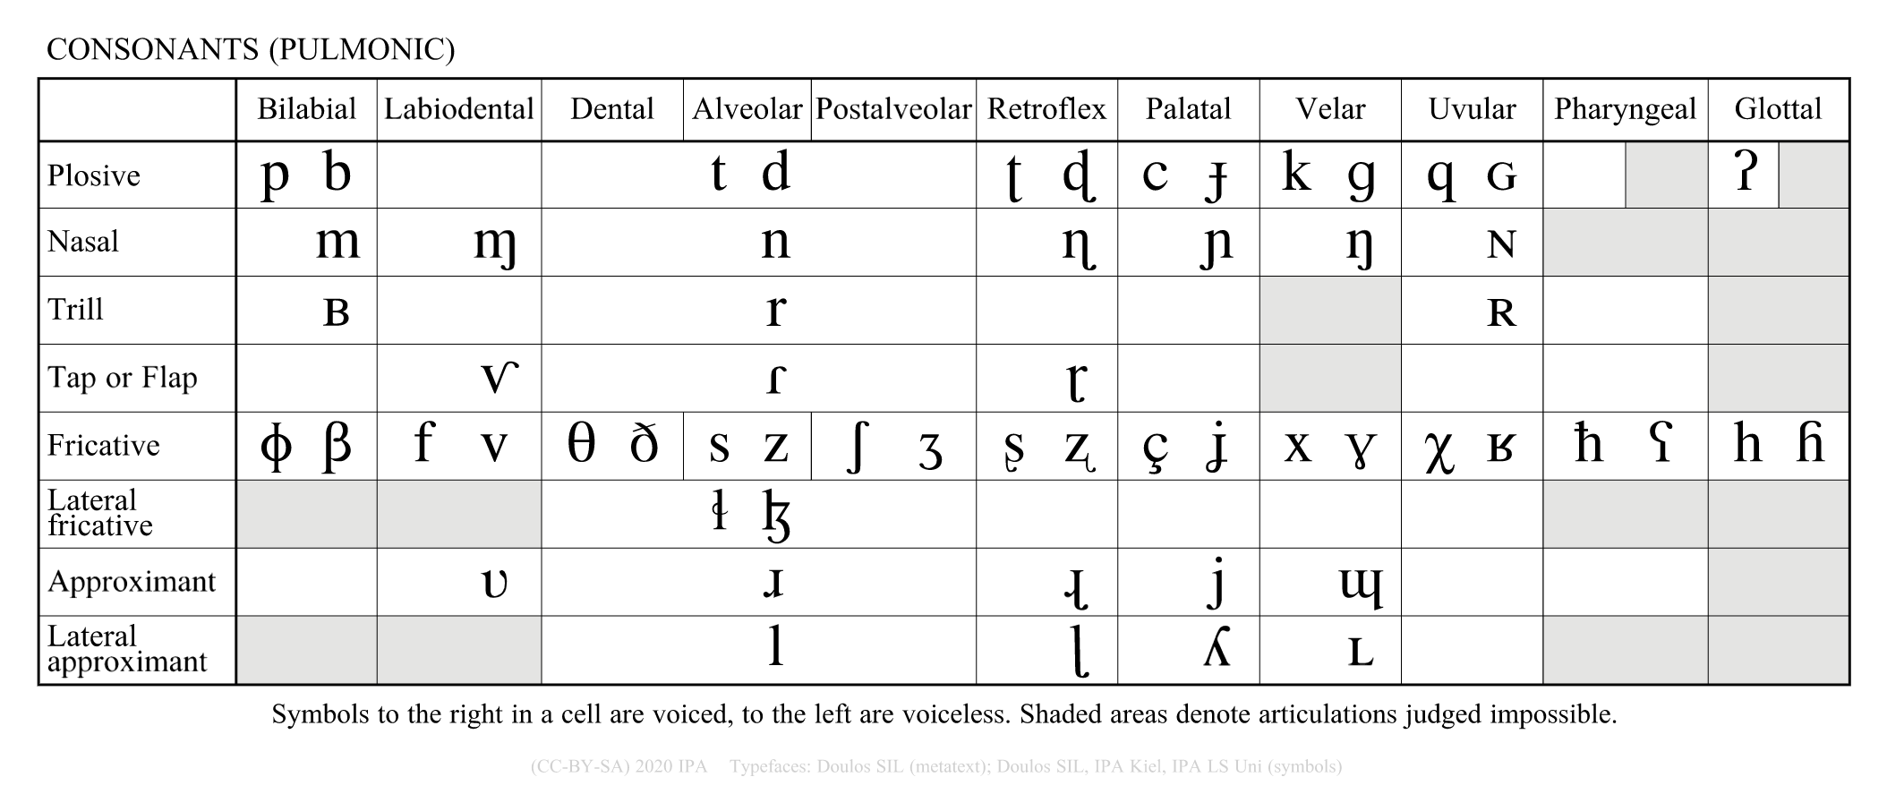
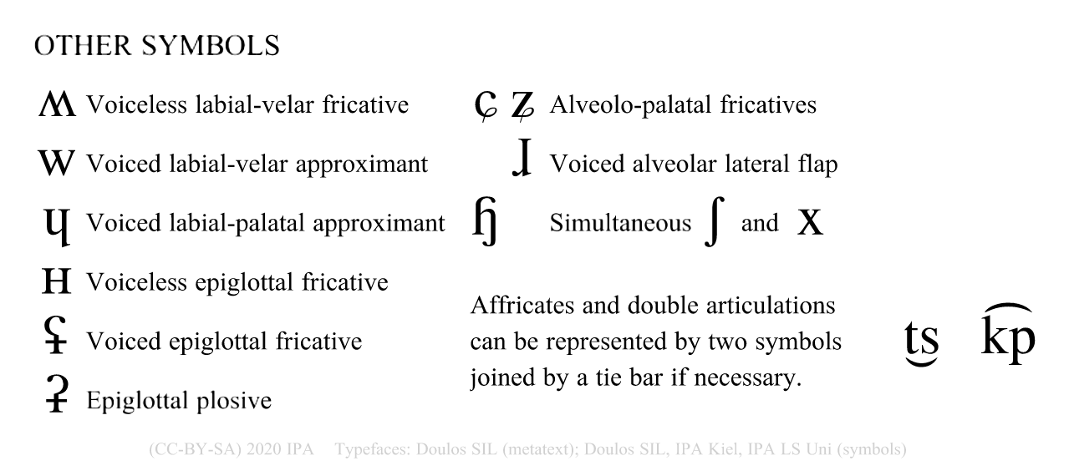








Consonant phonemes of English
Choose FOUR minimal pairs in your variety of English to highlight some consonant contrasts.
Good examples:
<Though> v. <dough> /ðoʊ/ v /doʊ/
<reed> v <seed> /ɹid/ v /sid/
Bad examples:
<though> v <do> /ðoʊ/ v /du/ (Two sound changes!)
<cede> v <seed> /sid/ v /sid/ (No sound change!)
Created by Antoin Rodgers under Creative Commons Attribution-ShareAlike 4.0 License - rodgeran@tcd.ie - @phonetic_antoin

